Slide 1

CRS Signify Group-E
Course
Registration
System
Kushagra (Leader)
Bhavish
Neeharika
Prinitha
Jyothirmai
Kartik

Slide 2

15 Days Interactive session
All interactive 3 weeks plans with daily and weekly review based on performance.
Everyday Discussion about topic introduction to new technologies and leaning module.
Every day with SME/Client discussion of Project progress & transformation based on backend Technologies

Slide 3
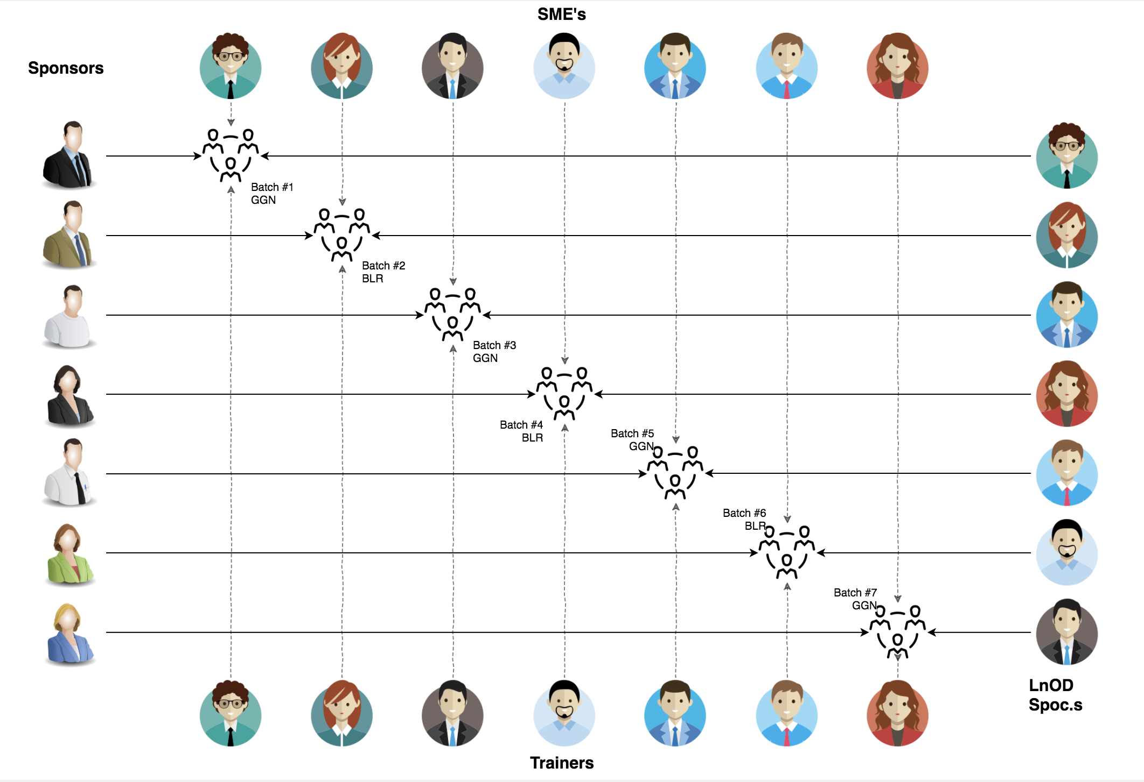
Stakeholders
Sponsors
Signify Innovations Labs
SME /Client
Amit Balyan
Coordinator
Seema Sandeep Shwetha Kumari

Slide 4

Agenda
01
Our Journey
02
Our Team
03
Team Structure
04
Project Goals
05
Engineering Practices
06
Tech Stack
07
Development
08
Challenges & Learnings
09
Demo
10
Questions
Notes:
Time – 1 min

Slide 5

The Course Registration System
TA client server system to ease the course registration process for the student. It facilitates the course assignment process for the faculty as well as the administration. It has following broad functions:
Administration Functions
Professor Functions
Student Functions
Notes:
Time – 3 mins

Slide 6
Problem Statement
The main goal of the application is to provide students with an easy and convenient way to register for courses and manage their personal information.
The system allows students to search for courses, add them to their schedules, and drop them if needed. It also provides faculty members with an easy way to view and manage student information and course registrations.
The system's development involves several steps, including defining the project scope, designing the user interface, implementing the server-side logic, setting up the database, testing and debugging the application, and deploying the application

Slide 7
 | Challenges | Learning
Week 1 | Understanding use case, requirements and problem statement Merge Conflicts in Git | UML Diagrams Git Commands and Version Control Use Case Scenario
Week 2 | Environment Setup Database Integration Exception Handling | Installation and setup of MySQL Workbench Using JDBC to connect to Database Implementing SQL queries
Week 3 | UI/UX Design Migrating POS Application to REST API | Designing REST Services Accessing services through API calls Integration of UI/UX using Angular with underlying backend
7

Slide 8
The Course Registration System
The updated system enables students to register for courses and view their report cards using personal computers connected to the campus LAN.
Additionally, professors have access to the system, which allows them to register for teaching courses and record grades.
To finish the development process to a close, we began by familiarizing with Git commands. Next, we built the core structure of the system using Java.
The backend was powered by Spring, and the database was managed using MySQL. We used Postman to test the API, while the frontend was developed with TypeScript for Angular.

Slide 9
3 WEEKS OF TRAINING + PROJECT DEMO
15 DAYS
360 HOURS
21600 MINUTES
1296000 SECONDS
LIMITLESS KNOWLEDGE

Slide 10
To Accomplish this project
Initially, we began by acquainting ourselves with fundamental Git commands to facilitate collaborative, non-linear development. Following that, we proceeded to install essential software tools required for the development process. Like :- Git, Java, Spring Tool Suite[STS], MySQL, Visual Studio Code etc..
Later used Java to develop the core structure of our project, and we opted MySQL as the database for our backend. Initially, we tested all the services using hardcoded data, but once we integrated with the database, we tested them using user input. Here we used Spring and MySql.
Additionally, we developed the corresponding REST controller services using Post and For the frontend development part used angular. 5

Slide 11
Technologies and why are they are used
Git →Version control system that allows developers to manage and track changes to their codebase over time Collaboration, Version control, Branching and merging, Backup and recovery.
Java → Provides a wide range of tools and features for full stack development Scalability, Robustness and reliability, Rich libraries and frameworks.
Spring Boot→ Creates a backend API that can handle requests and provide responses to frontend applications. Dependency Injection, Simplified development, Integration, Modularity.

Slide 12
MySQL→ Open-source relational database management system Scalability, Performance, Compatibility, Open-source.
Postman→ POSTMAN is an API client used to develop, test, share and document APIs Test API endpoints, Automation, Debugging
TypeScript and Angular→ It is a superset of JavaScript that adds optional static typing and other features to the language. Angular is open-source front-end framework. Type safety, Tooling and Compatibility. Modular architecture , Two-way data binding and Cross-platform development.

Slide 13
CRS
Mindset
Process
5
CRS Project
Tools
4
Adapting to a developer
Mindset
Comprehend
3
Design Thinking
2
JAVA
1
Understanding Project Goals

Slide 14
Team Structure
Team Member | Responsibility
Kushagra | Databases and schema design
Bhavish | Implementing of Java and functional logic
Neeharika | UI Designing using Angular, POS client functionalities
Prinitha | Implemented the student functionalities
Jyothirmai | Implemented the admin functionalities and Front end
Kartik | UI-UX Design
14
14
Notes:
Time – 2 mins

Slide 15




Our Vision
Insights
To create an course Registration System using full stack development tools and technologies, where a Student can register for course, view Grade card and Change Password Professor can view Enrolled Students and Add Grades Admin can Approve Student, Add Professor, Generate Reportcard, and Assign Professor to Course
1
2
Quality
Security
3
4
Interactivity
Speed
Notes:
User satisfaction and brand value

Slide 16
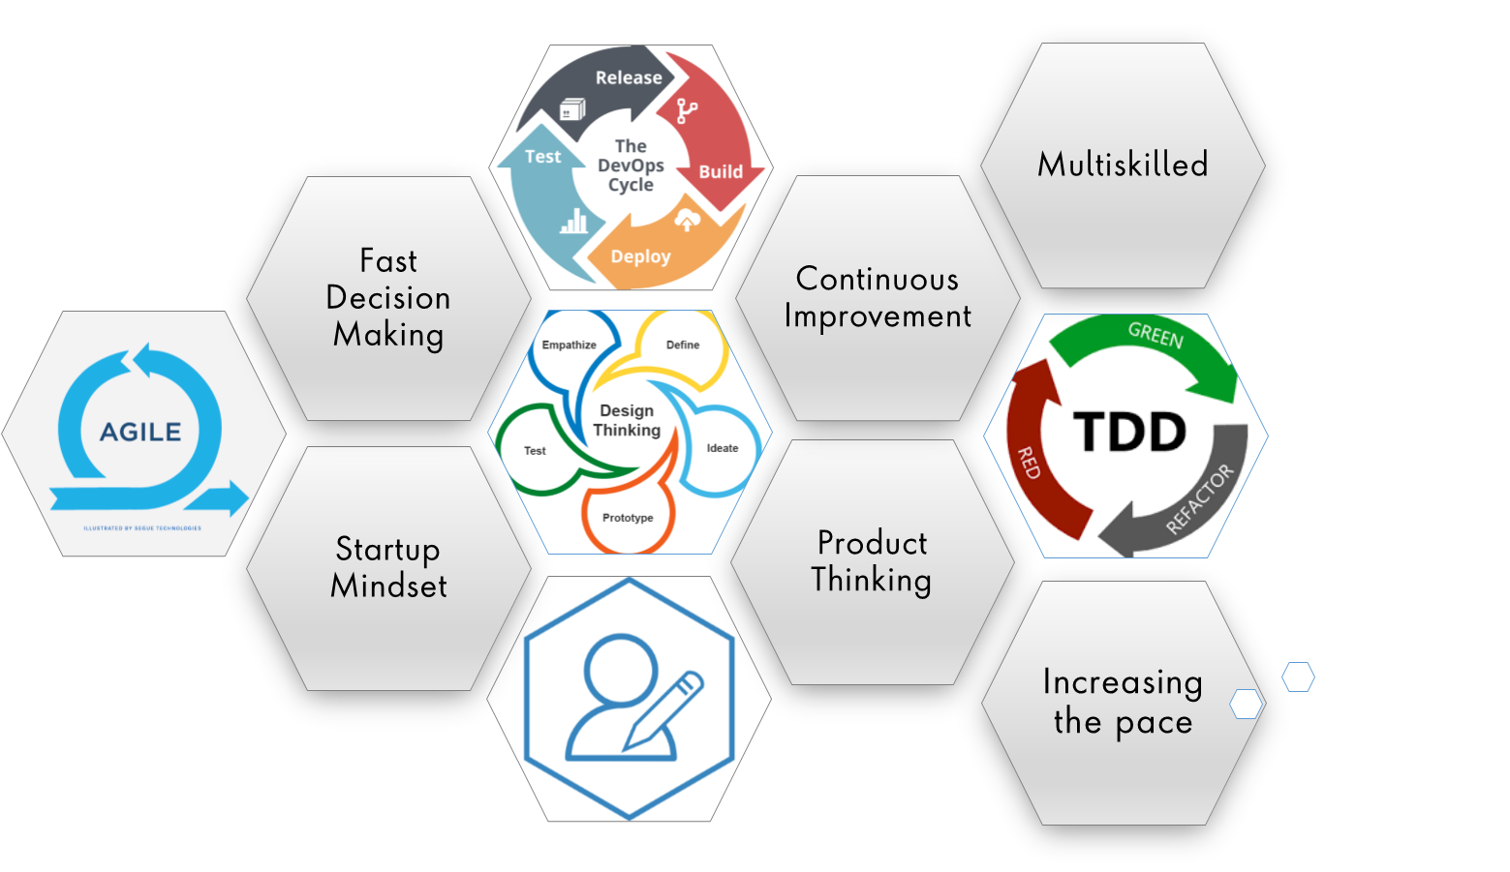
Engineering Practices : Agile
Notes:
Product Thinking (Design Thinking, Requirement Analysis, )
Multi Skilled (Frontend, Backend, DevOps)
Fast Decision Making (Agile)
Increasing the Pace (Automation CI/CD)
Startup Mindset (Agile)
Continuous Improvement (Retros)

Slide 17






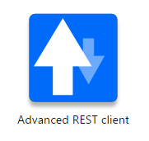





Tech Stacks Used
Backend
TOOLS
TESTING
Frontend
Spring
Notes:
Time – 1 min

Slide 18

Demo
Notes:
Time –
Architecture – 5 mins
NFR Dashboard – 3 mins
Demo – 10 mins
1. Show the Responsiveness and Wave tool first

Slide 19

Questions
Notes:
Time - ?

Slide 20

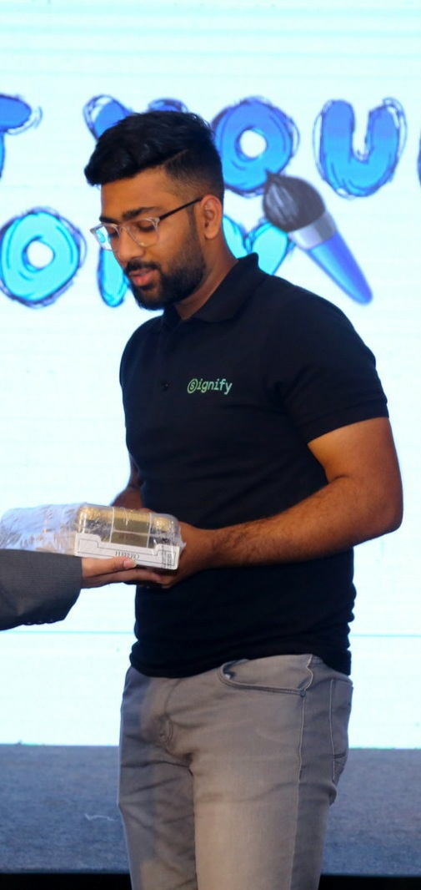
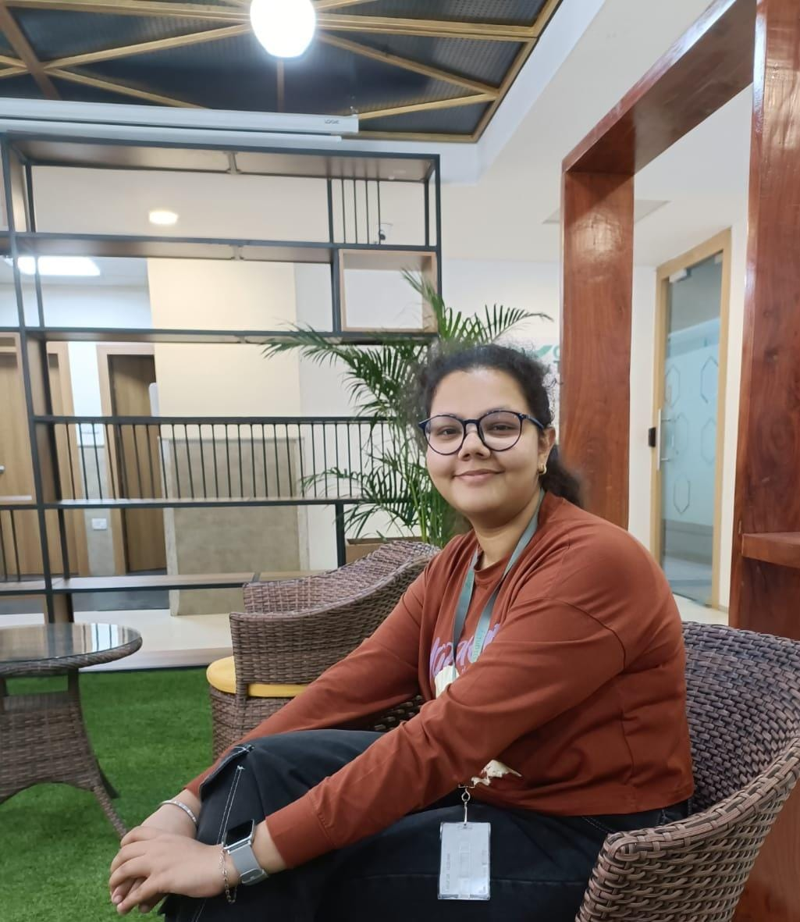
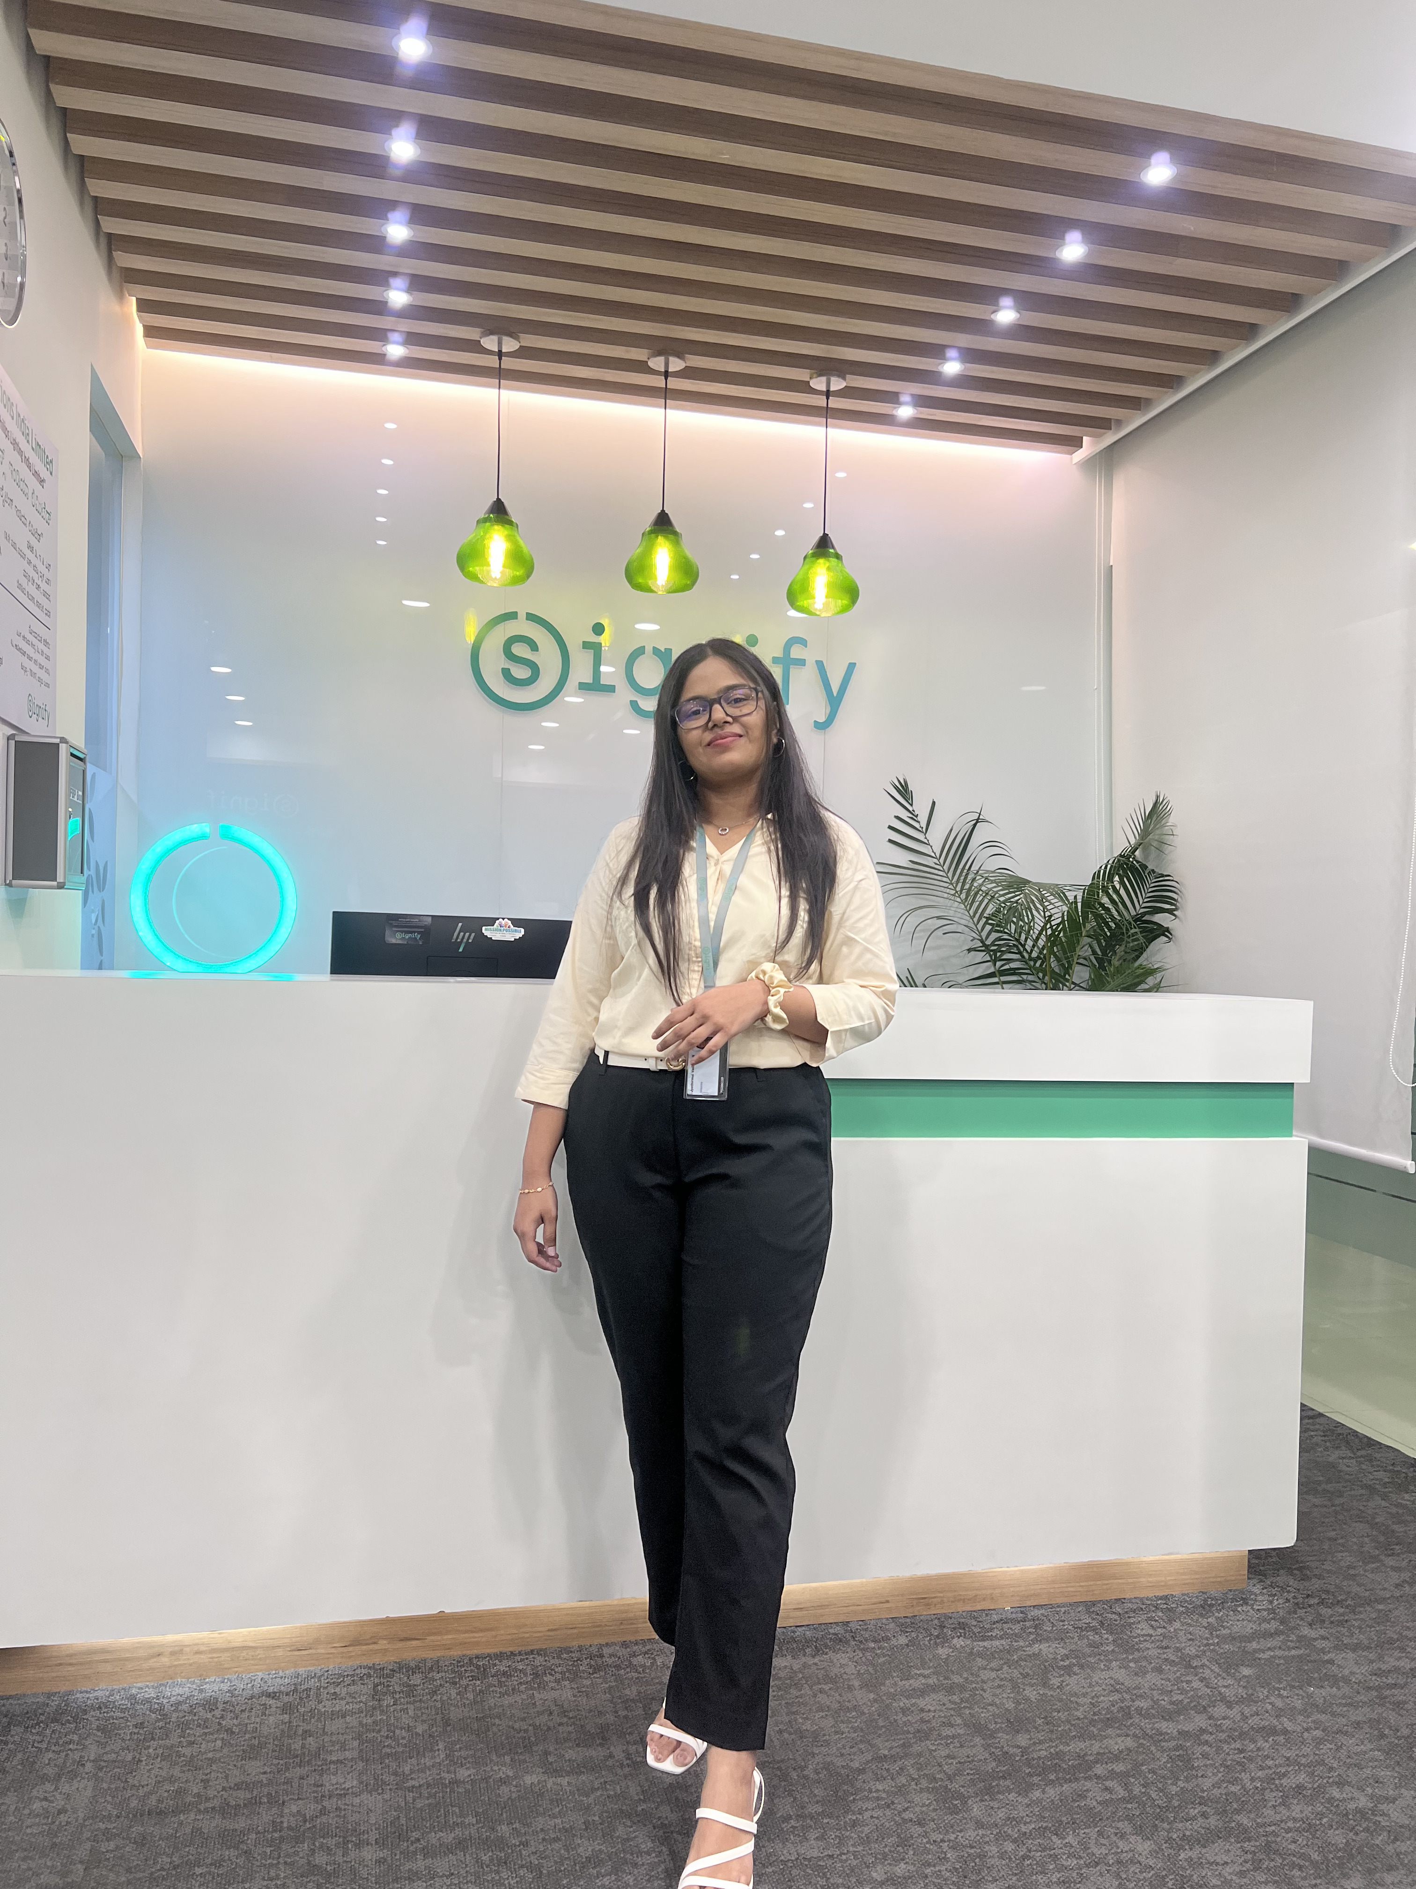
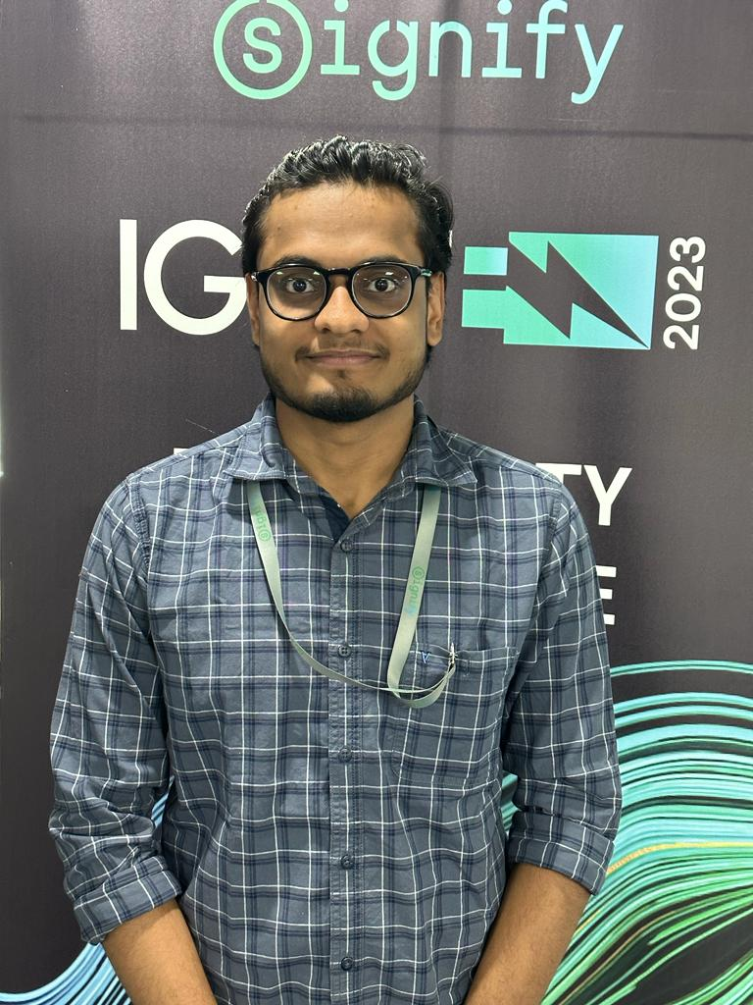
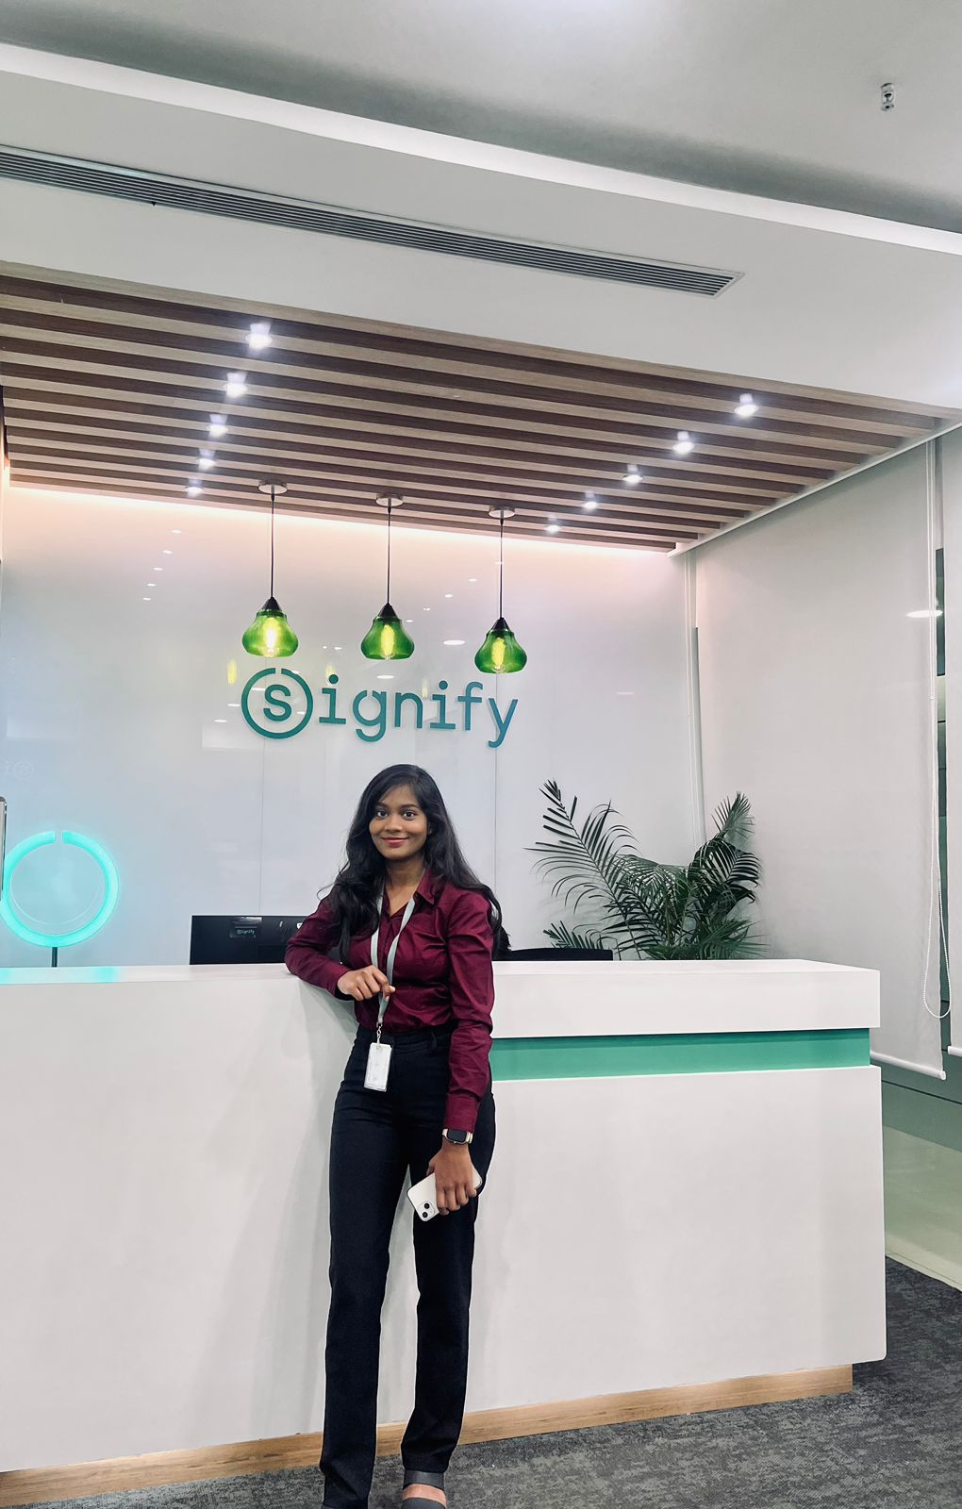
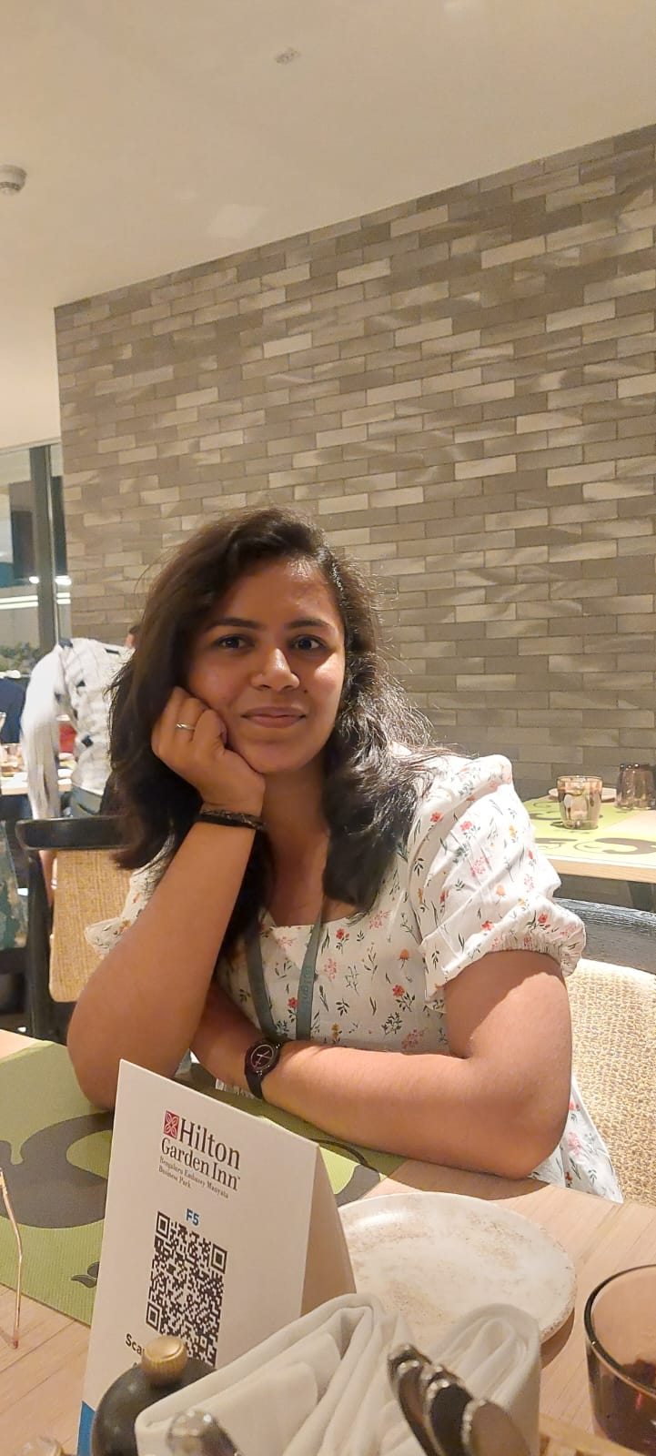
Our Team
Kushagra Gupta(Leader)
Bhavish
Jyothirmai
Kartik
Neeharika
Prinitha
Notes:
Time – 2 mins

Slide 21
Thank you
Notes:
Time – After this show the testimonial video. 1 min

